Slide 1
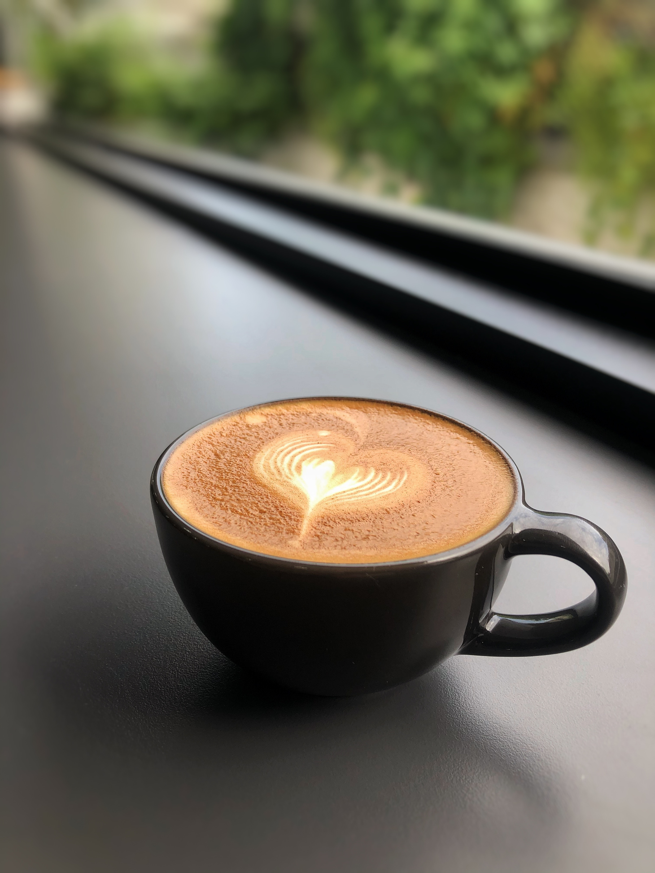

Bright Coffee Shop Analysis
WELILE MTHEMBU

Slide 2

Objectives
1.Products that generate the most revenue.
2.Time of the day the store performs best.
3.Sale trends across products and time intervals.
4. Recommendations.

Slide 3
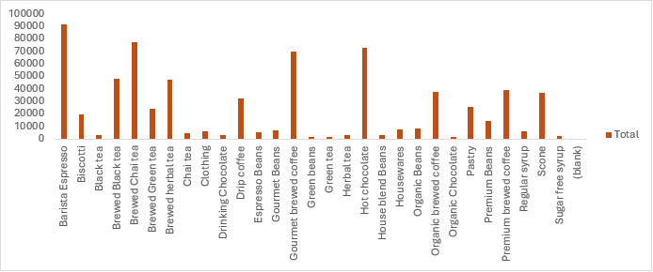
Total Revenue Per Product Type

Slide 4
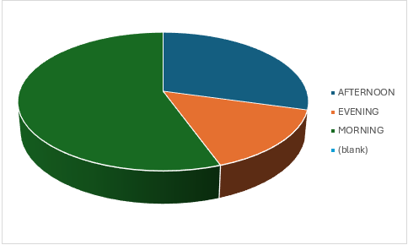
Peak Time Intervals For Sales
6AM -11:59AM = MORNING
12PM - 16:59PM = AFTERNOON
17:00PM - 20:59PM = EVENING
THE HIGHEST SALES VOLUMES OCCUR DURING THE MORNING PERIOD

Slide 5
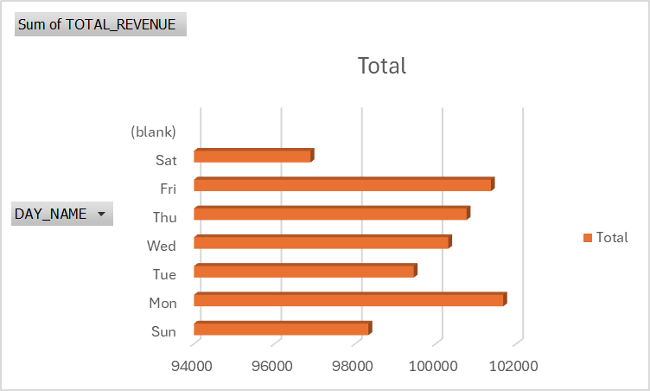
Revenue Generated On Each Weekday
REVENUE PEAKS ON MONDAY, WITH FRIDAY AND THURSDAY SHOWING SIMILARLY STRONG PERFORMANCE.

Slide 6
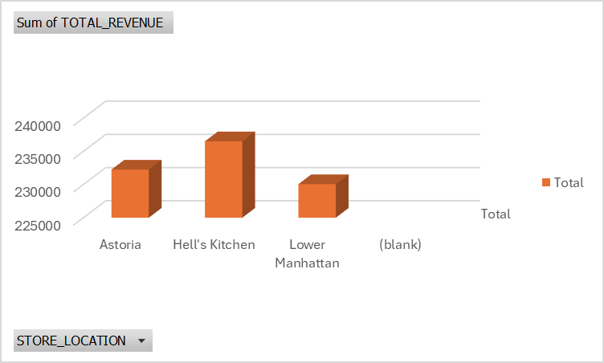
Total Revenue Per Store Location
HELL’S KITCHEN GENERATES THE MOST REVENUE

Slide 7
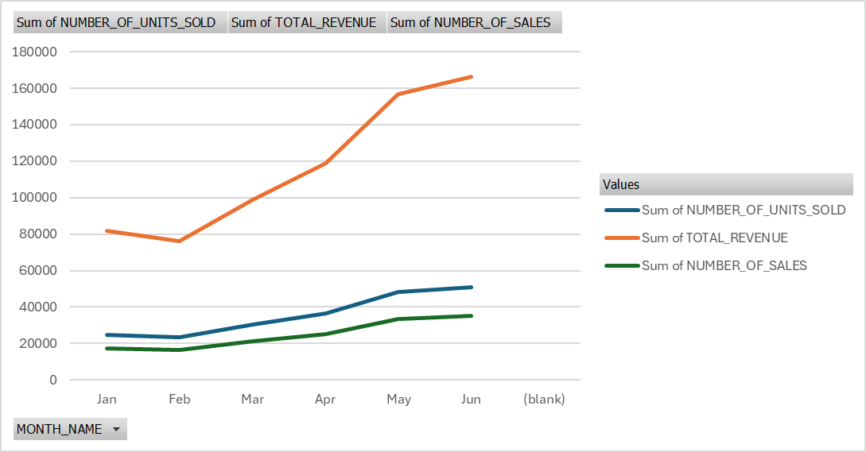
Total Revenue Between Jan -Jun
THERE WAS A DROP IN OVERALL REVENUE BETWEEN JANUARY AND FEBRUARY
THE INCREASE IN SALES BEGAN IN MARCH, WITH JUNE DELIVERING THE STRONGEST REVENUE PERFORMANCE.

Slide 8
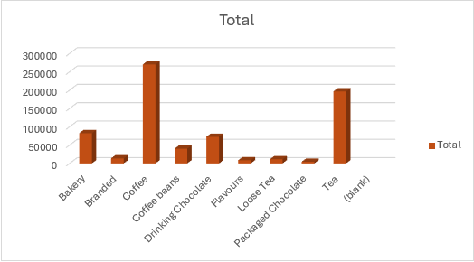
Total Revenue By Product Category
.

Slide 9


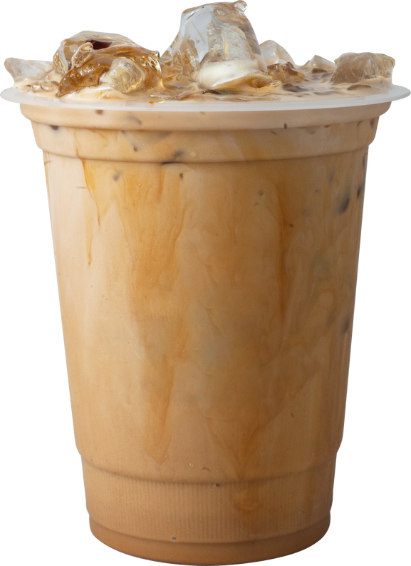
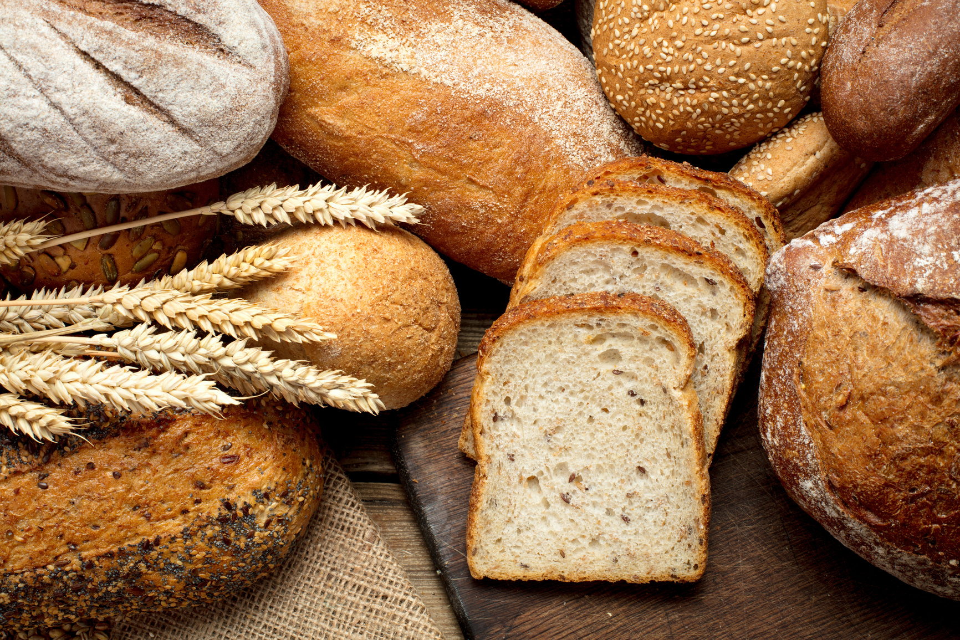
Top 4 Selling Products
1.COFFEE
2. TEA
3. BAKERY
4. DRIKING
COFFEE

Slide 10
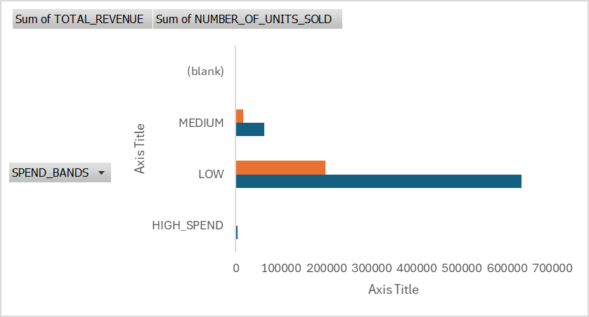
Revenue By Spending Bands
SPEND BANDS
0 – 100 = Low
101 – 250 = Medium
251 – 300 = High
With the low spend category generating the most revenue, efforts should be directed toward strengthening the medium and high spending customer base.

Slide 11

RECOMMENDATIONS
Drive customer loyalty through structured reward tiers or exclusive subscription benefits.
2. Increase transaction value through product bundling, such as offering a free coffee with the purchase of a branded mug.
3. Introduce exclusive local or seasonal pastries to generate excitement and keep the menu fresh.
4. Enhance the appeal of packaged chocolate through custom, gift-ready packaging to attract impulse and seasonal buyers.

Slide 12

THANK YOU!

